Slide 1
Social-Emotional Learning (SEL) and Mental Health Services-Student Support
Dena Gill, LMSW, LSSW
Dr. Overall’s Mental Health Team
Shelby County Schools Mental Health Center (SCSMHC)
Student Equity Enrollment & Discipline Department

Slide 2
Mental Health Center & Schools
What is Mental Health?
Social and Emotional well-being
Thoughts, Behaviors, and Emotions
What is Mental Illness?
A Change in Mood, Thinking, and Behavior
Shelby County Schools Mental Health Center (SCSMHC)
Mental Health Support in all Shelby County Schools
Licensed by Tennessee Department of Mental Health and Substance Abuse (TDMHSAS)
Mission: To provide psychological and social support services to foster emotional well-being, accelerate academic achievement, eliminate barriers to student success and promote safe and drug-free schools.

Slide 3
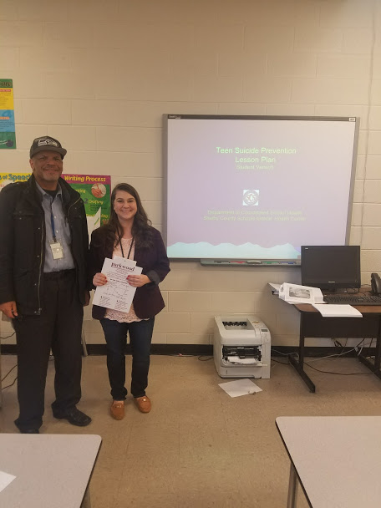
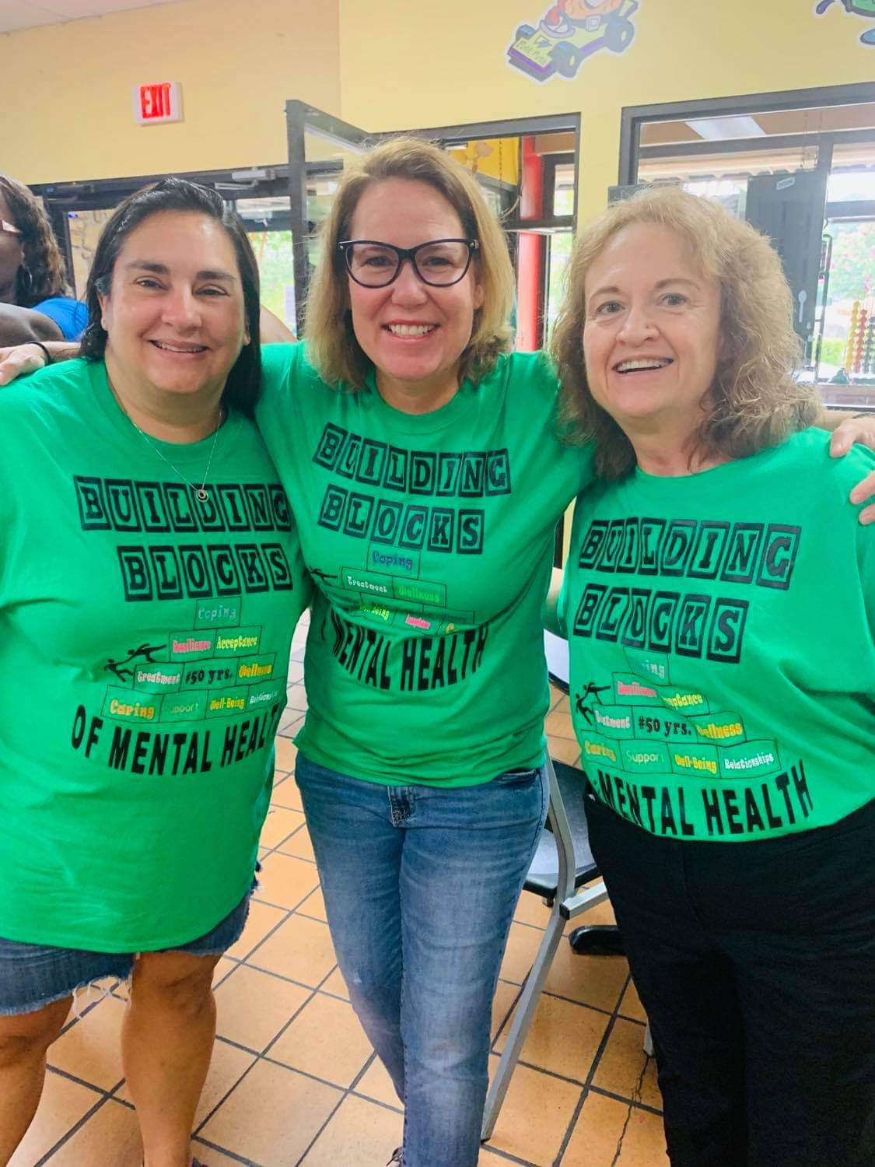
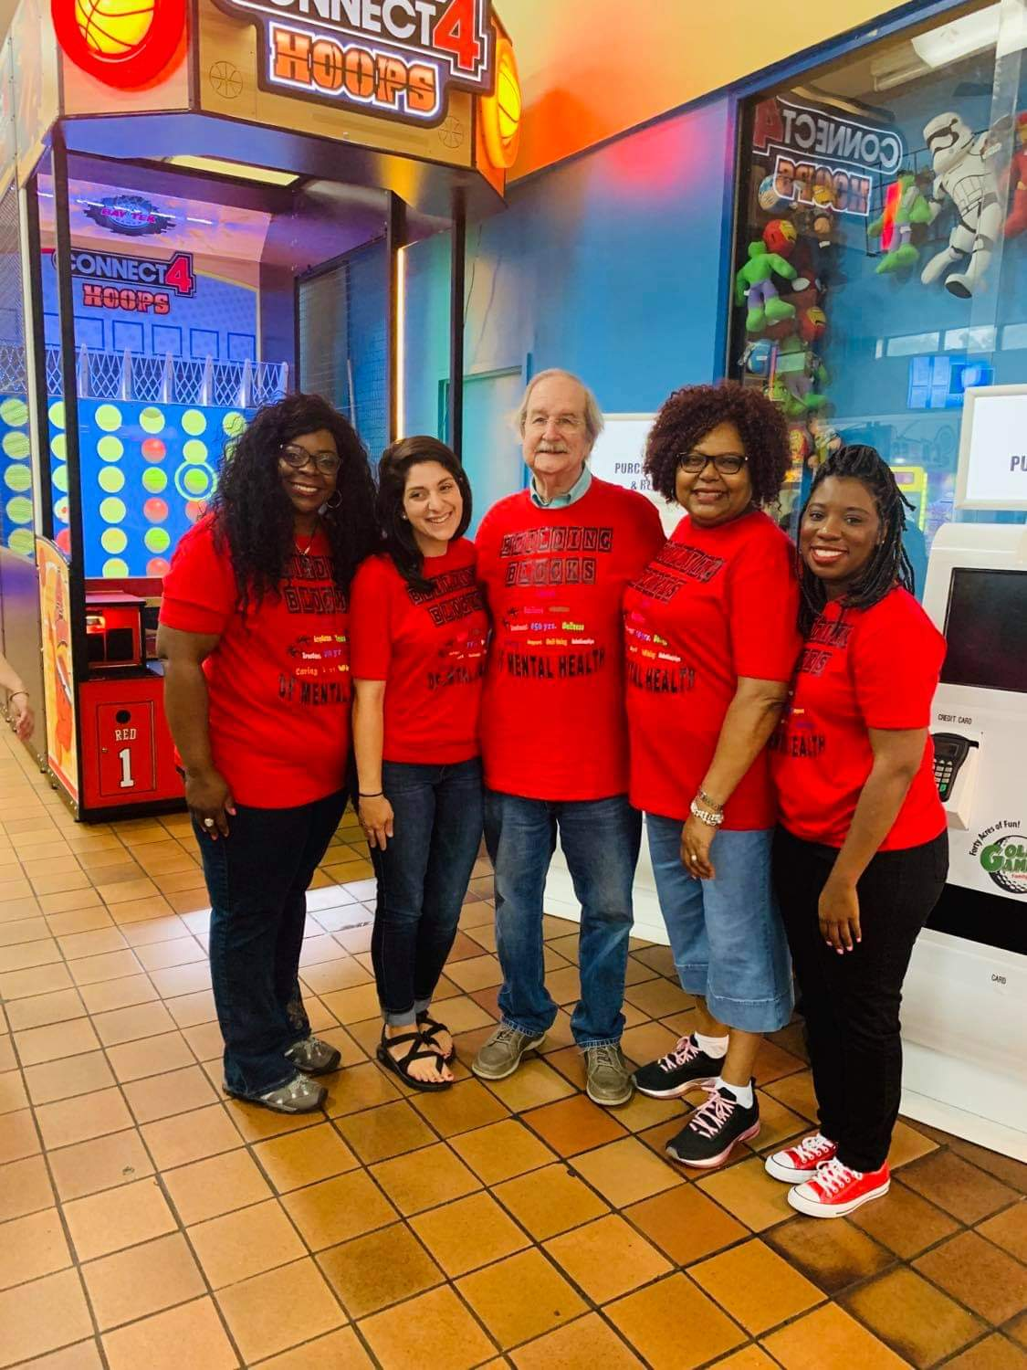
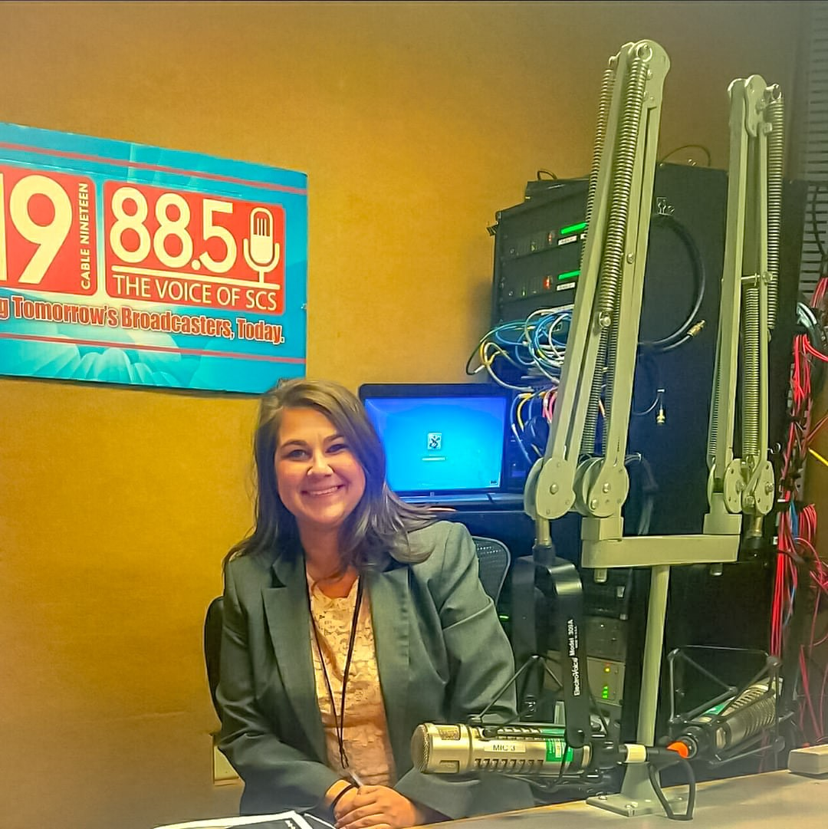
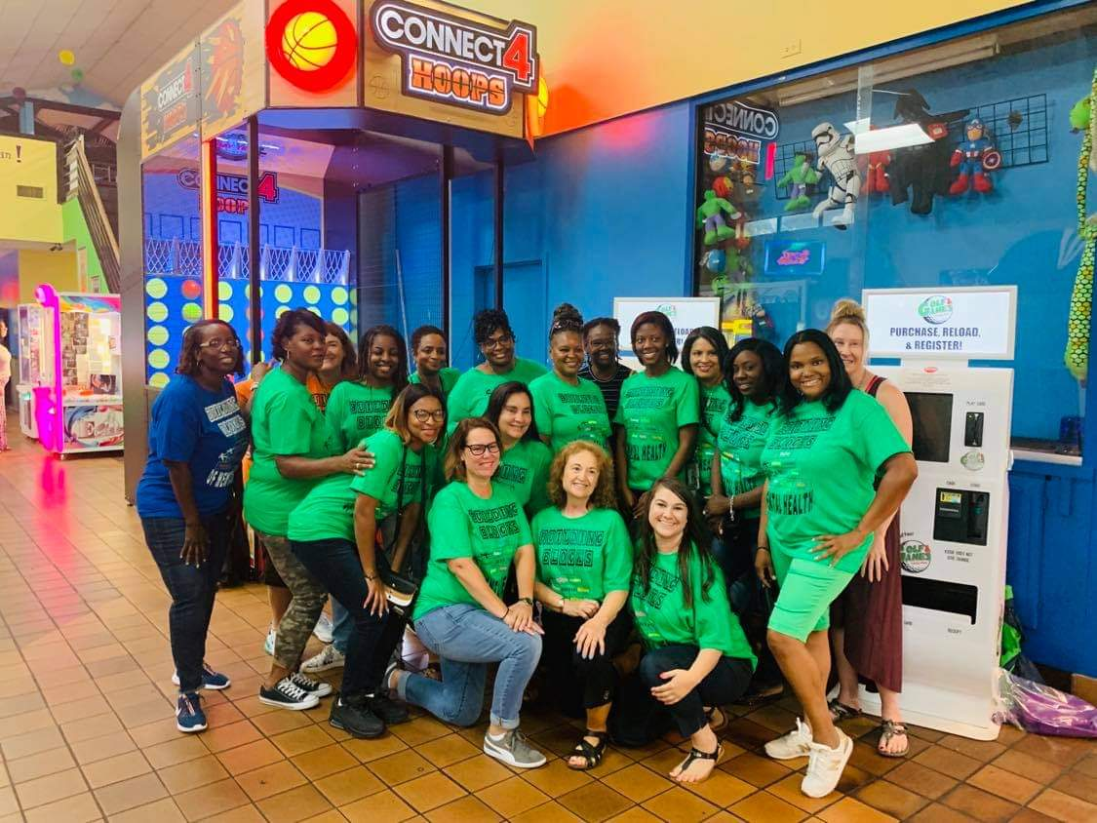
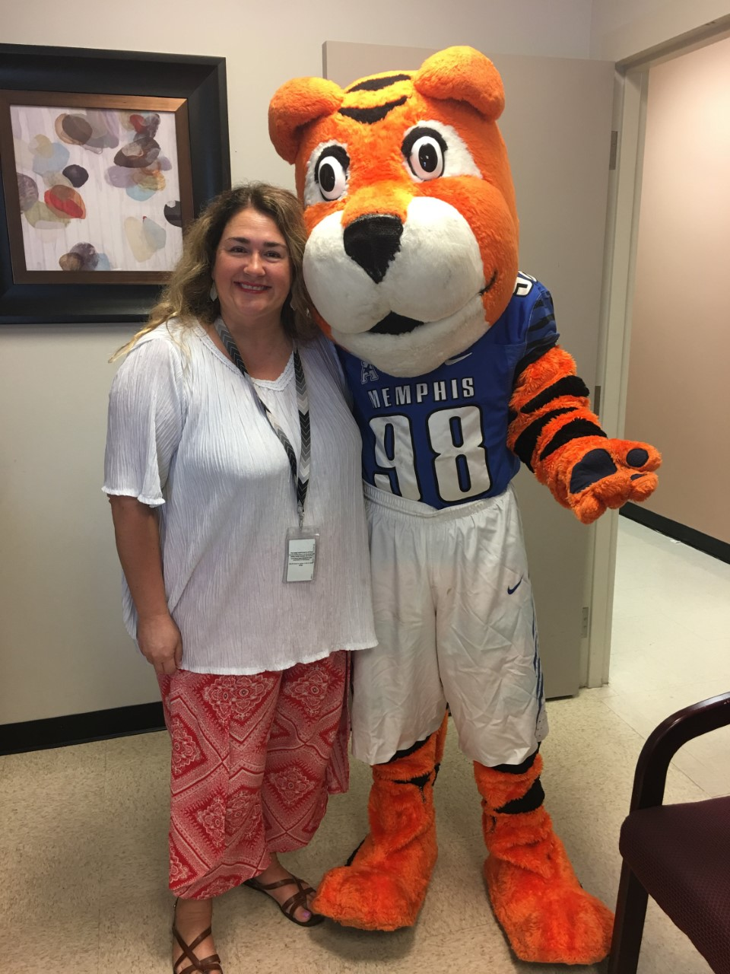
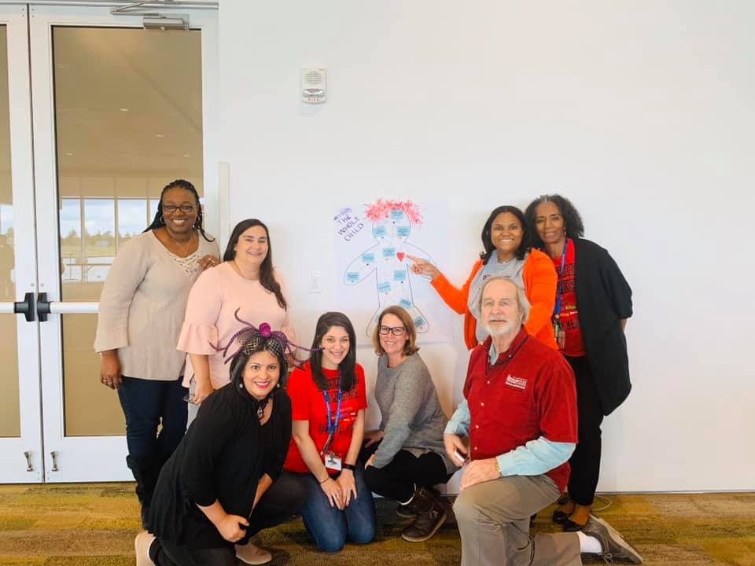
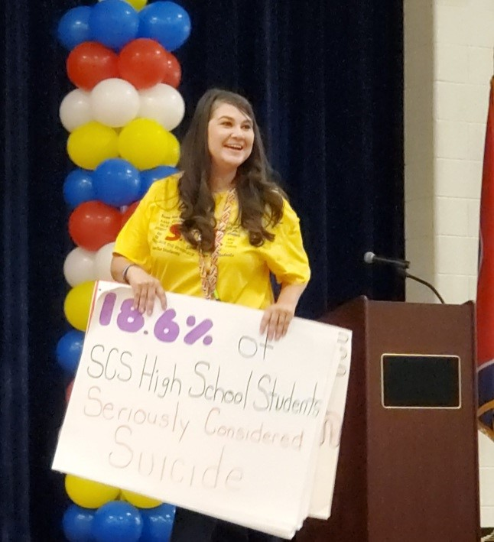
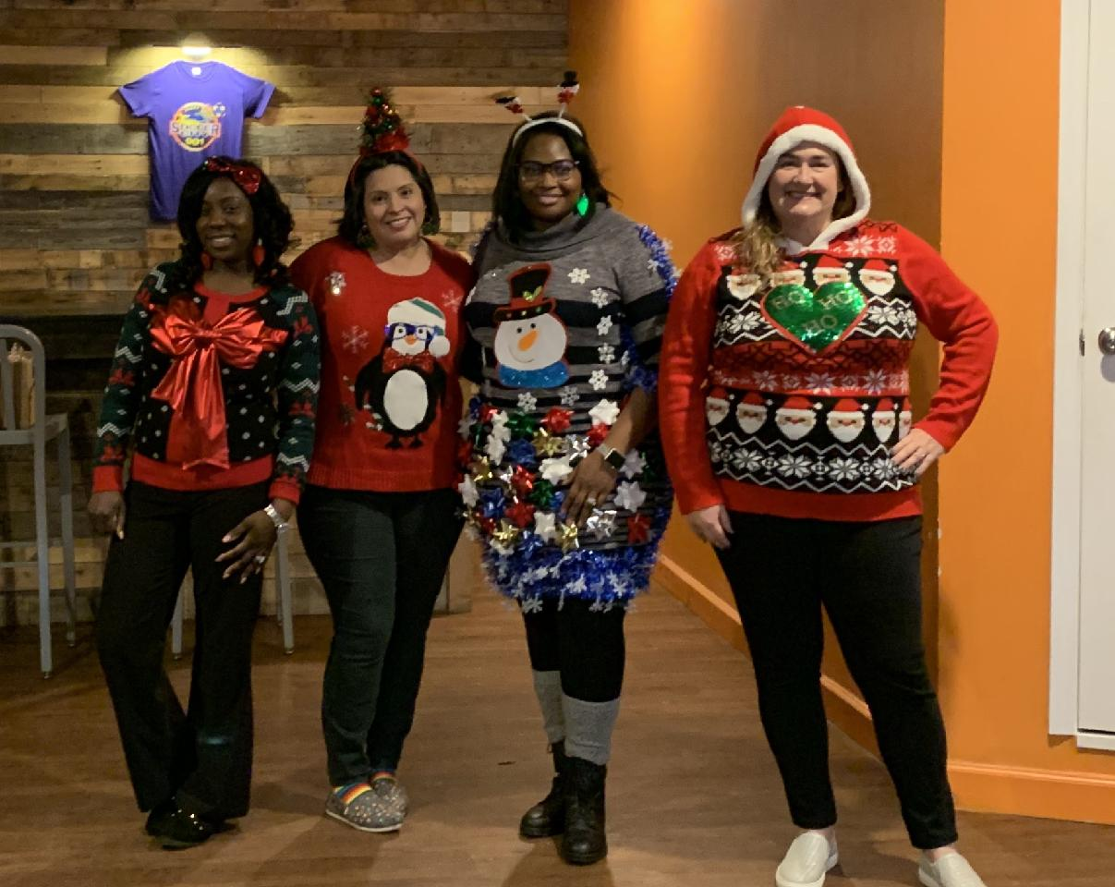
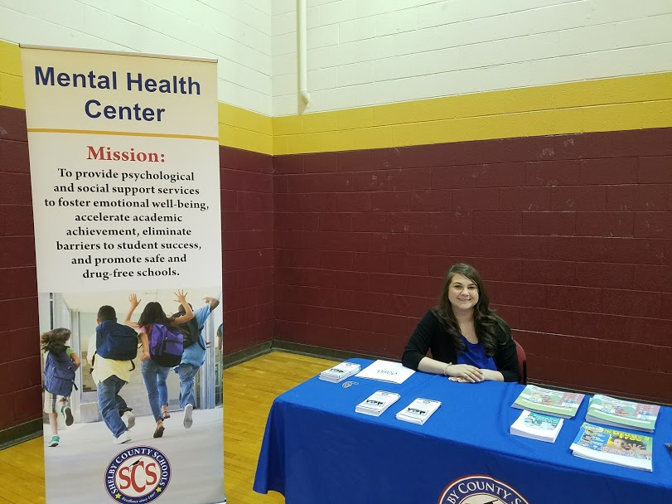
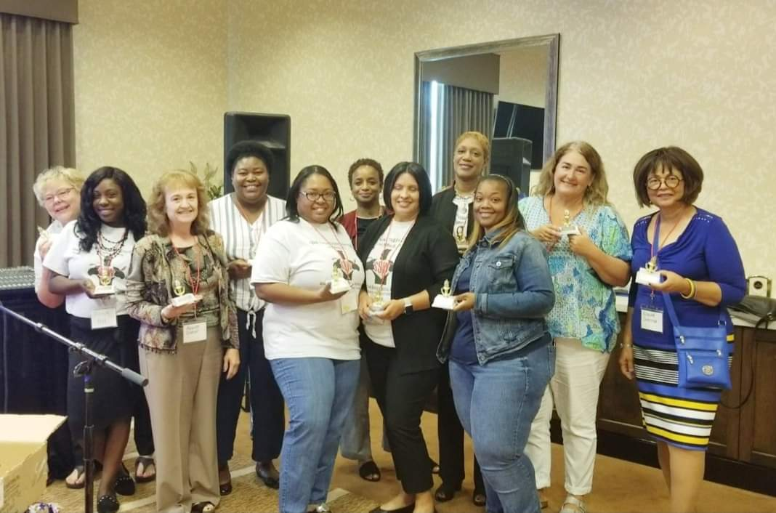
SCSMHC Staff: Meet the Clinicians

Slide 4
Mental Health Clinician: Roles & Responsibilities
Mental Health Support
Conduct individual/group/family counseling
Respond to crisis/emergencies (School Hours)
Current Address and Phone Number(s) Needed
CIT Police (901) 545-2677, Shelby County Sheriff (901) 397-7625 or Youth Villages Specialized Crisis Services (866) 791-9226 (After School Hours)
Provide Consultation to Teachers, Parents, Administrations, and/or Nurses
FBA/BIPs
Resource Linkage
Attend 504/IEP/S-Team/SRT meetings

Slide 5
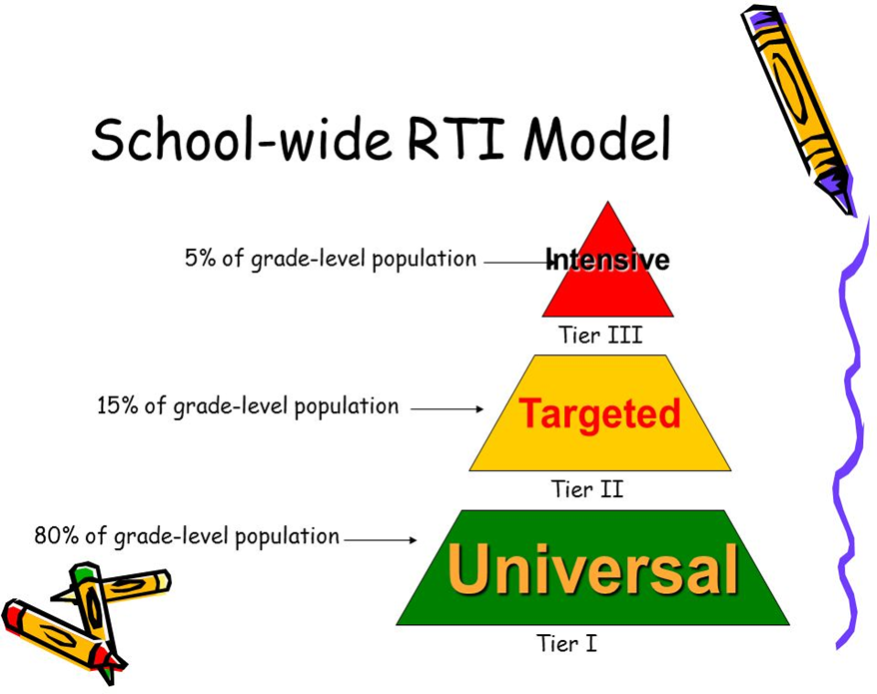
Mental Health Services & Schools: Multi-tiers of Student Support
Tier 1
School Wide Intervention
PBIS/RTI2-B, Classroom Presentations (often in collaboration with the PSCs)
Tier 2
Early Intervention (Social Emotional Learning-SEL skills)
Group Counseling centered on topics such as: Learn-readiness skills, Conflict-Resolution skills, Grief, Problem-Solving/Decision-Making skills, Anger Management/Emotional Regulation skills, Self-Esteem/Concept, Bullying, etc.
Tier 3
Intensive Therapeutic Intervention
1:1 Individualized Support
Students often seen at this tier have been diagnosed with a mental health disorder, have emotional and/or behavioral challenges that impacts their overall well-being and academic success.

Slide 6
Frequently Asked Questions: Access to Mental Health Services
Services will be available to work with students in a virtual format beginning August 31st
Parent/Legal Guardian consent is needed to provide services (excludes ages 16+)
Teletherapy sessions will be held on Microsoft TEAMS
A dial in option is available if student/family does not have access to internet or electronic device
Referral Form (a completed referral form is required)
Reason for Referral (Briefly Describe Problem)
Strategies Used to Address Behavior
Strengths/Weakness of Student and/or Family
Consent for Mental Health Consultation (PSC assists)

Slide 7
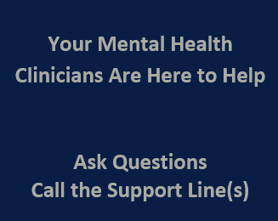
Referrals
SEL Support Line: 901-416-8484
SEL Support Line Hours: M-F (9a-4p)
Parents and School Staff can call the hotline for referrals, resources, and other info
Don’t Forget to Fill Out the Referral Form
Referral forms must be given to School Social Worker for consultation/follow-up
Referrals forms can also be given to PSCs

Slide 8
Service Considerations: Service Accessibility and Delivery
Working Together to Provide Services:
Brainstorm with School Social Worker for Student and Service Access
A time suitable to provide services for all necessary parties involved
Student, Mental Health Clinician, and School Staff
Identify a process to alert school staff if a student may be tardy to a virtual class due to services
Notify Teacher and School Attendance/Truancy Clerical Assistant

Slide 9
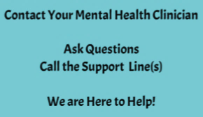
Have Questions?
Contact Your School Mental Health Clinician
Call the SEL Support Line at 901-416-8484
Want to know more about various mental health diagnoses and topics?
Call 901-416-2266 for pre-recorded information
It takes a village and the SCSMHC is happy to serve the students and families of the Shelby County Schools Community!

